Slide 1
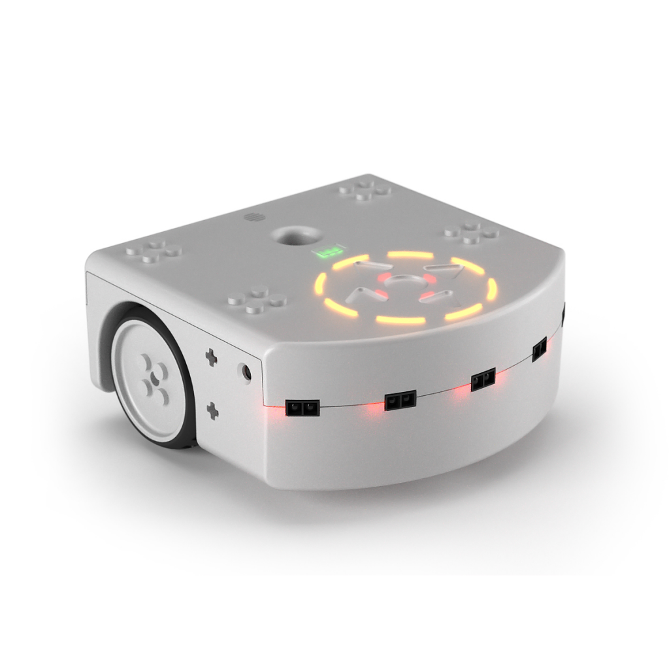

Maze solver
Gobbetti Alessandro, Bhardwaj Lovnesh, Xintan Lin

Slide 2
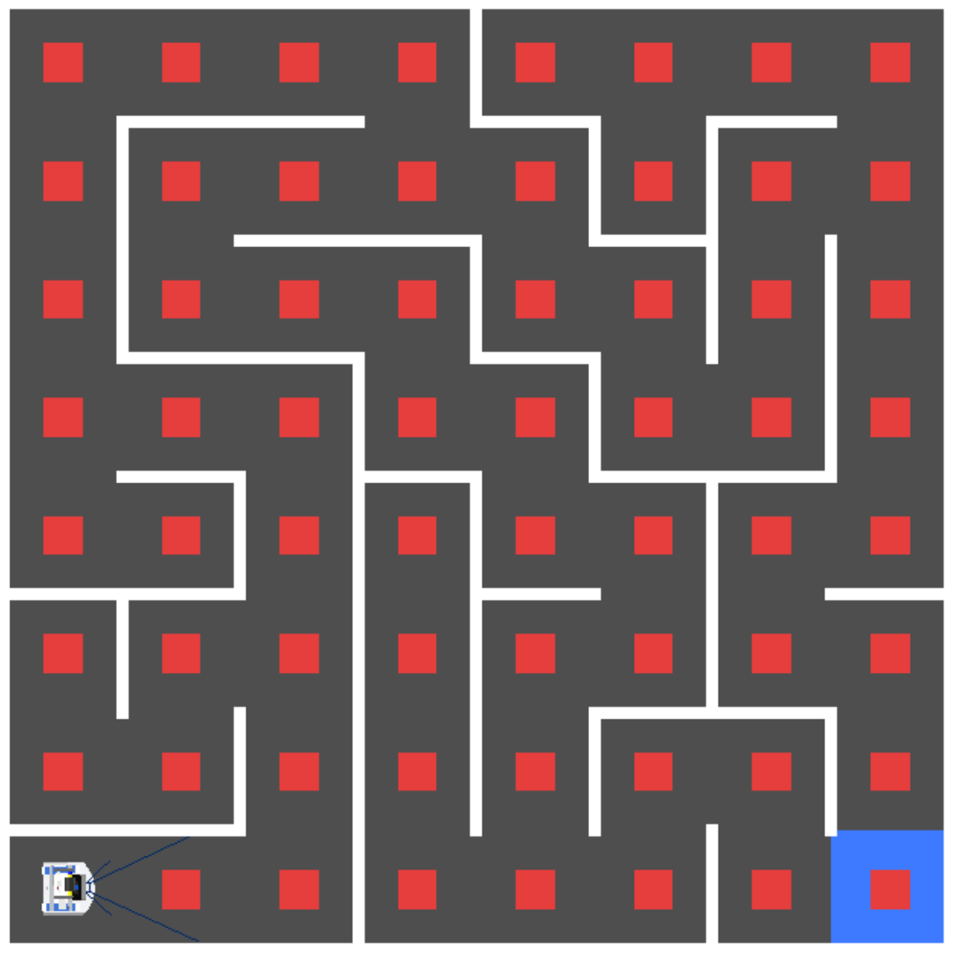
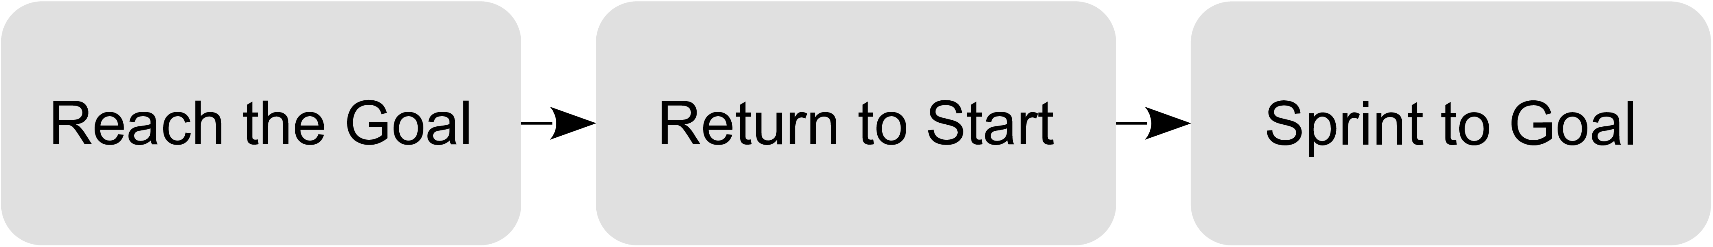
Micromouse maze solver

Slide 3
Program mechanism
Move Robot
flood fill algorithm
Solve maze
Find the next direction cell
Detect environment
Detect walls around robot
Align robot in middle
Solve maze
Map scene to maze matrix
Locate robot current cell
Move robot to next cell

Slide 4
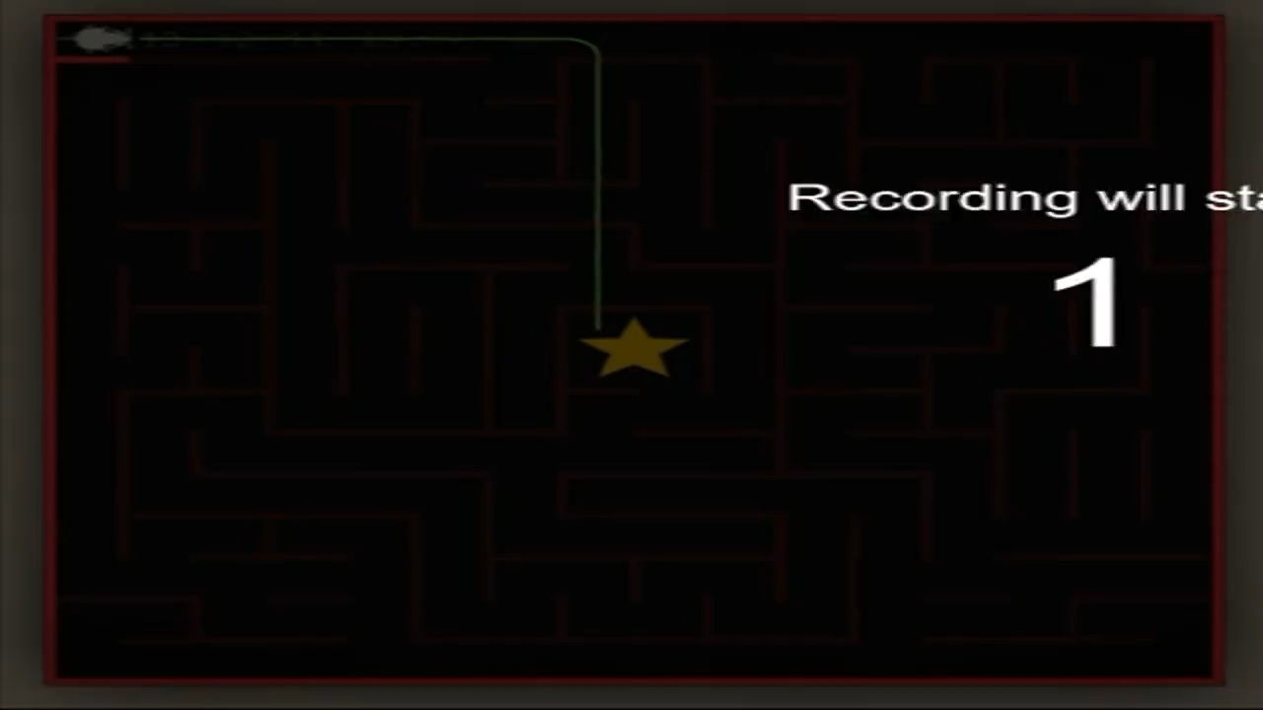
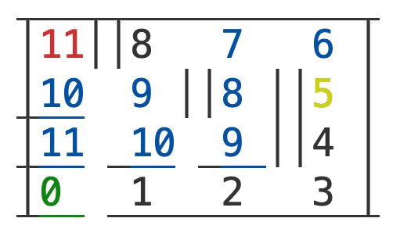
Flood Fill Algorithm
Find the values of neighboring cells (from the flood array)
Go to the neighboring cell with the least value.
Detect left, right and front walls
Update the newly found walls in the maze array
If needed, perform the flood fill on the neighboring cells in the flood array
Back to step 1 until the robot reaches the goal

Slide 5
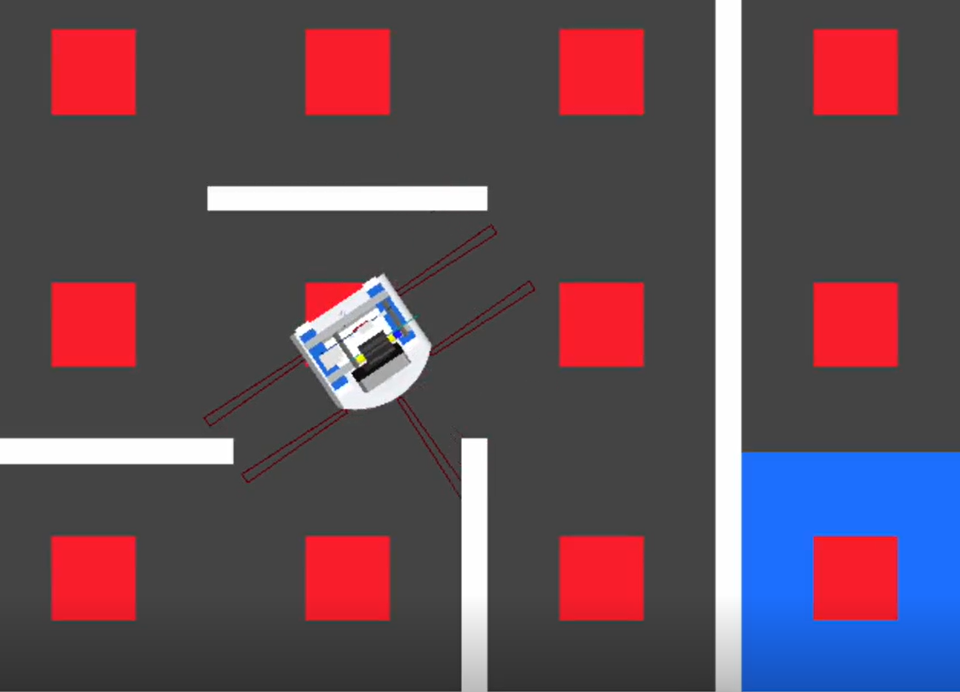
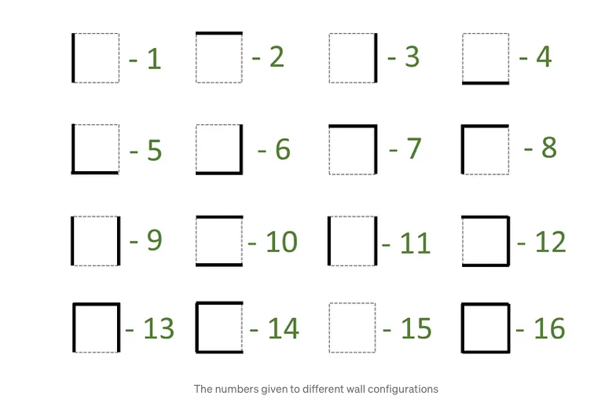
Detect WALLS
Proximity sensor detect 16 wall states:
Use proximity sensors to detect surrounding walls

Slide 6
Moving The Robot
Where are we?
Move to next cell

Slide 7
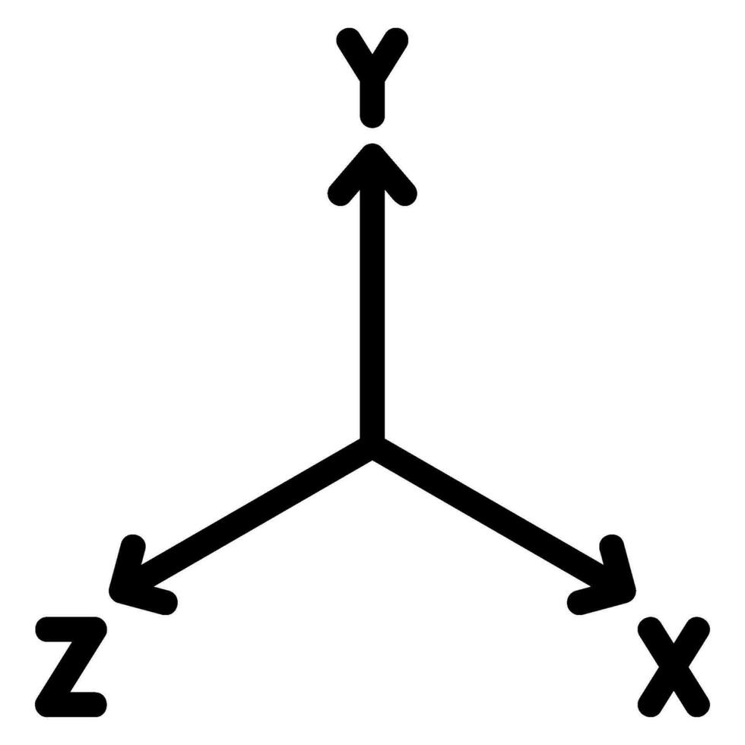
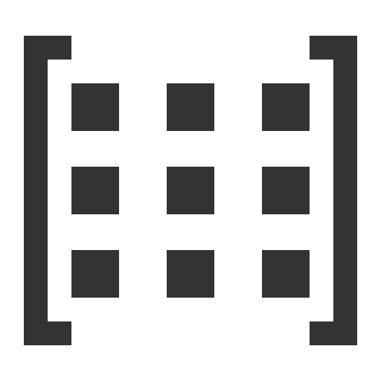
Odometry
Odometry coordinates
Maze coordinates

Slide 8

ODOMETRY
?
?
?

Slide 9
Improving Odometry and Navigation

Slide 10
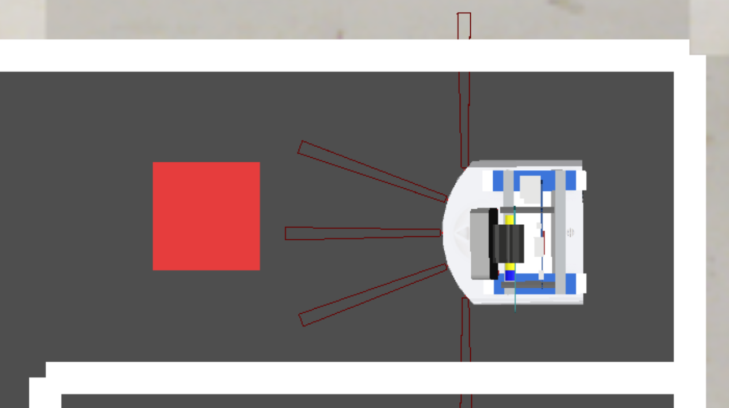
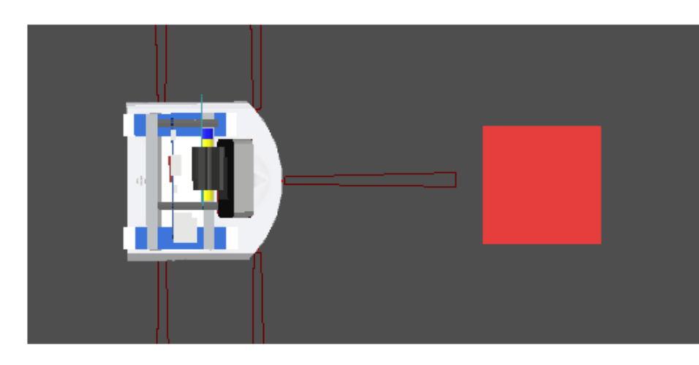
Improving Odometry and Navigation

Slide 11
Improving Odometry and Navigation
PID controllers for wall alignment

Slide 12
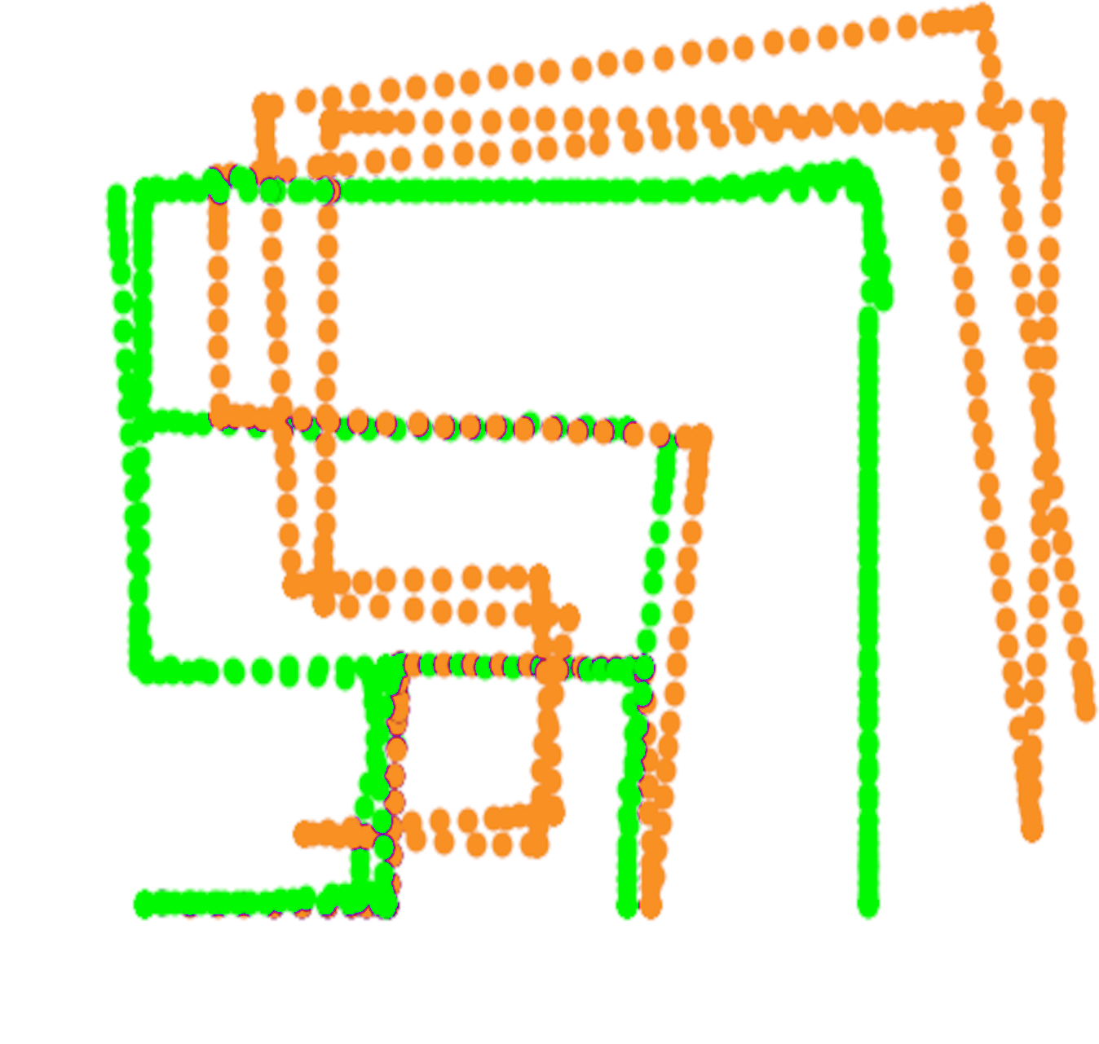
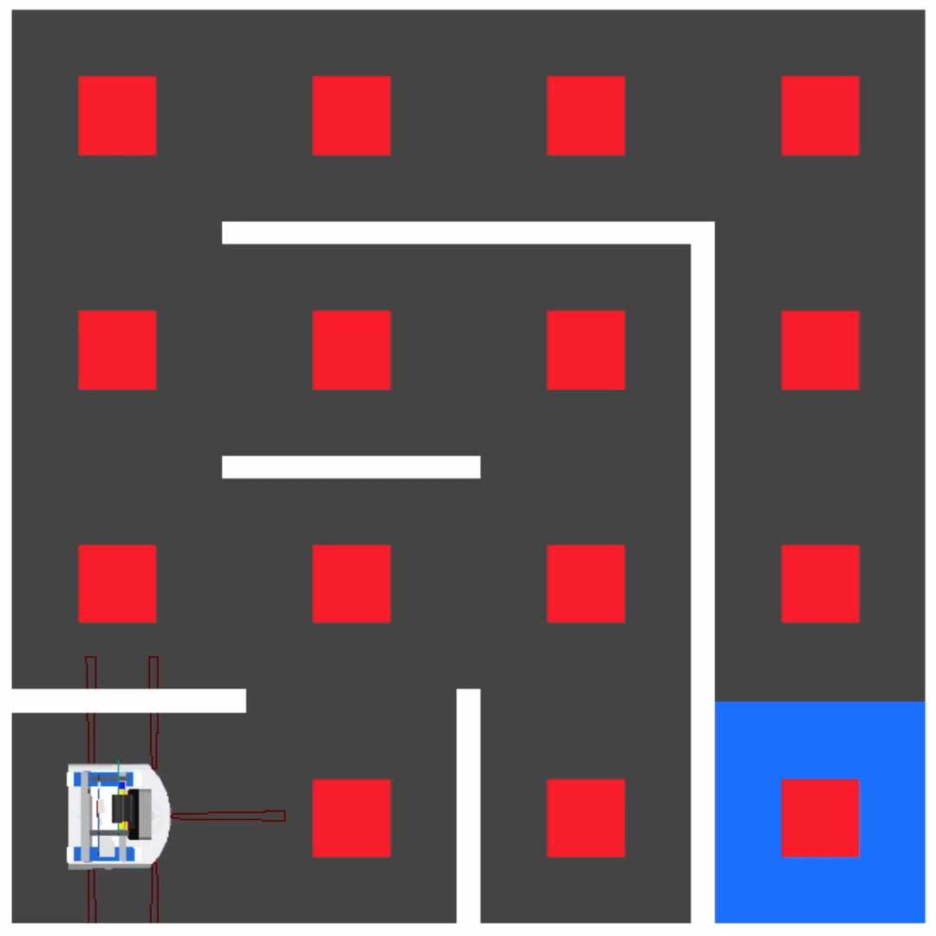
Improving Odometry and Navigation
2x speed

Slide 13
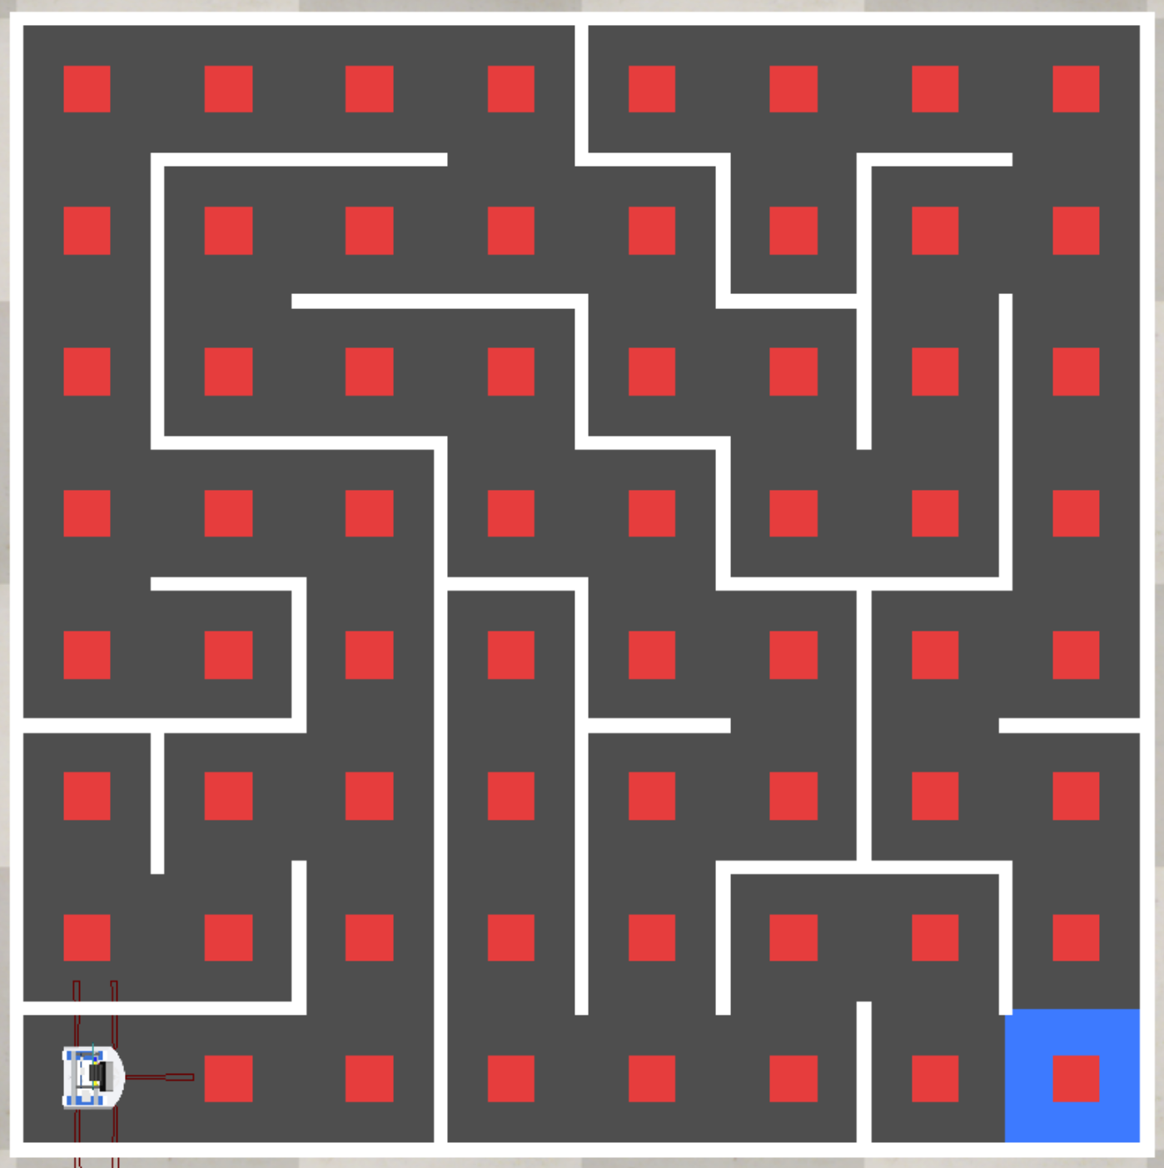
Improving Odometry and Navigation

Slide 14
Using the camera
Changes made to the orientation of the camera of the thymio.
OpenCV to recognise the red-square at the bottom and move to it.
Alignment only with respect to the x-axis.
A little movement forward to the center of the cell to mitigate the loss of rectangles in the feed when moving.

Slide 15
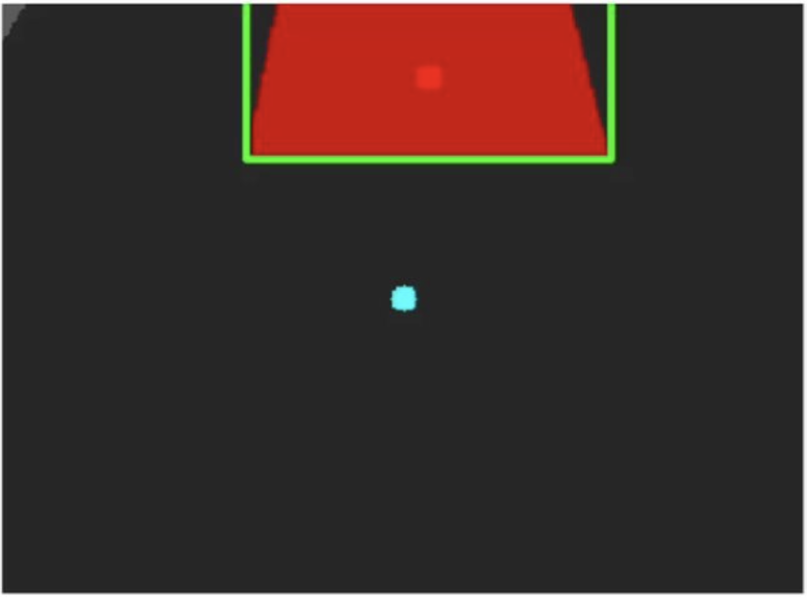
Using the camera
Alignment to the center of the bounding rectangle.
Alignment takes care of odometry angle issues as it corrects to the center of the bounding rectangle resulting in no error accumulation.

Slide 16
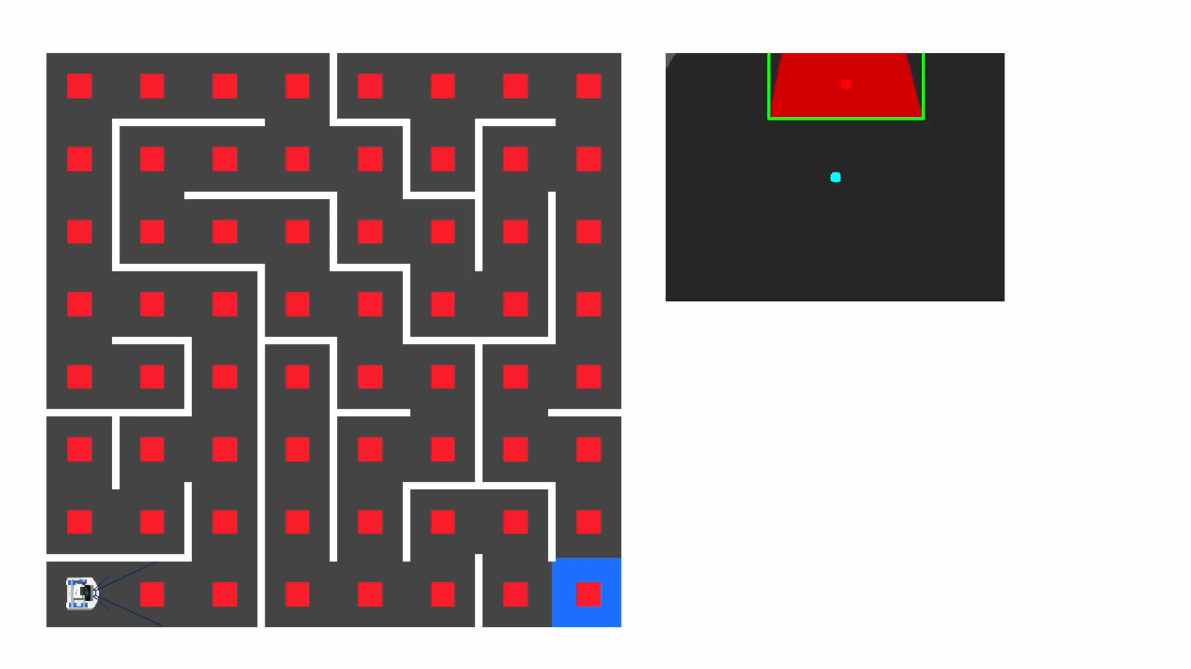
Using the Camera
2x speed

Slide 17
Thanks

